Slide 1

Pytest

Slide 2


Slide 3
What is Mutation Testing?
Mutation testing evaluates the quality of your test suite by:
1. Creating Mutants: Small changes are made to your source code
2. Running Tests: Your test suite runs against each mutant
3. Checking if tests detect the change: Tests should fail when run against mutants
4. Calculating Score: Percentage of mutants killed by your tests

Slide 4
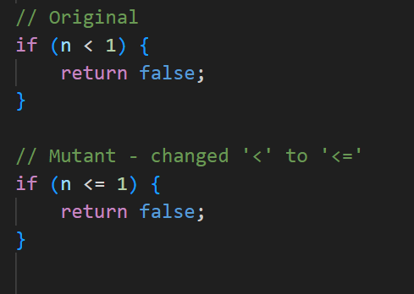
Common Mutations (Mutators)
- Change `>` to `>=` or `<`
- Replace `true` with `false`
- Change `+` to `-`
- Remove method calls
- Modify constants

Slide 5
Pitest Metrics Explained
Mutation Score: `(Killed Mutants / Total Mutants) × 100`
Killed: Test failed when run against mutant (good!)
Survived: Test passed despite code change (potential issue)
No Coverage: Mutant in uncovered code
Timed Out: Mutant caused infinite loop
The closer to 100%, the stronger your test suite

Slide 6
Key Features
Execution through bytecode manipulation
Integration with popular build tools (Maven, Gradle)
IDE plugins available
Supports JUnit and TestNG

Slide 7
Advanced Features
Incremental Analysis: Can only re-tests changed code.
Mutation Operators: Fine-tune which code transformations to apply.
History Recording: Track test suite improvements over time.
CI/CD Integration: Automate Pitest in build pipelines.

Slide 8

Live Demo

Slide 9
Key Actions
1. Focus on surviving mutants first
2. Add tests to kill surviving mutants
3. Review equivalent mutants
4. Iterate to improve mutation score

Slide 10
Pros
Increases Confidence: Shows your tests actually detect bugs.
High-quality Reports: Pinpoint weak spots visually.
Actively Maintained: Supports modern Java, large community.
Extensible: Plugins, custom mutators, integrations (e.g., PIT Pro).

Slide 11
Cons
Execution Time: Mutation testing is slower than normal tests; can be heavy on CI.
Resource Usage: Can tax CPU/memory on large projects or CI runs.
Interpretation Required: Surviving mutants aren’t always meaningful defects. Complex Setup: Requires initial setup and tuning for large projects.

Slide 12
Thank you
https://github.com/JoaoGuilhermedeSa/pitest

